Slide 1
Sentiment analysis
ARTIFICIAL INTELLIGENCE &
MACHINE LEARNING PROJECT
Presented By:
Swaroopa Bhupalam - Srinivasa Ramanujan Institute Of Technology - Computer Science and Engineering (Data Science)

Slide 2
OUTLINE
Problem Statement
Proposed System/Solution
System Development Approach
Algorithm & Deployment
Result
Conclusion
Future Scope
References

Slide 3
Problem Statement
Title: Sentiment Analysis of Restaurant
Customer reviews are critical for the success of any restaurant, providing insights into customer satisfaction and areas needing improvement. However, manually analyzing a large number of reviews is time-consuming and often impractical. An automated sentiment analysis model can streamline this process by quickly categorizing reviews and highlighting overall customer sentiment.

Slide 4
Proposed Solution
The proposed system aims to develop a sentiment analysis model for classifying restaurant reviews as positive or negative, the following step-by-step approach will be employed. The solution will consist of the following components:
Data Collection:
Identify sources of restaurant reviews such as Yelp, Google Reviews, TripAdvisor, and Zomato.
Use web scraping tools like BeautifulSoup and Scrapy, or APIs provided by review platforms to collect a large dataset of restaurant reviews.
Data Preprocessing:
Convert text to lowercase, remove stop words, and apply stemming or lemmatization.
Split the text into individual words or tokens. Ensure each review is labeled as positive or negative.
Machine Learning Algorithm:
Choose suitable machine learning models such as Logistic Regression, Naive Bayes, Support Vector Machines (SVM), Random Forest, or deep learning models like Recurrent Neural Networks (RNN) or Transformers (e.g., BERT).
Deployment:
Create a user-friendly interface (e.g., web app) where users can input new reviews and get instant sentiment analysis results.
Implement visualizations to display the sentiment distribution of reviews over time or across different categories.
Evaluation:
Implement a feedback mechanism to allow users to correct the model's predictions, thereby improving the model over time.

Slide 5
System Approach
The "System Approach“ for the Sentiment Analysis of Restaurant outlines the overall strategy and methodology for developing and implemention.
System requirements : It includes both Hardware and Software.
Hardware Requirements – Processor, RAM, Storage
Software Requirements – Windows 10 or 11, Python 3.7, macOS
Libraries : BeautifulSoup, Pandas, Numpy, NLTK, Matplotlib, Seaborn, Scikit-learn

Slide 6
Algorithm & Deployment
In the Algorithm section, describe the machine learning algorithm chosen for classifying restaurant reviews as positive or negative.
Algorithm Selection:
Provide a brief overview of the chosen algorithm (e.g., machine learning model like Logistic Regression, Naive Bayes, or deep learning model like LSTM, BERT) and justify its selection based on the problem statement and data characteristics.
Data Input:
Specify the input features used by the algorithm, such as the text of the review, metadata like rating scores (if available), and any other relevant factors.
Training Process:
Explain how the algorithm is trained using the collected review data. Highlight any specific considerations or techniques employed, such as text preprocessing (tokenization, stemming, lemmatization), vectorization, cross-validation.
Prediction Process:
Detail how the trained algorithm makes predictions for new reviews. Discuss any real-time data inputs considered during the prediction phase and how the model handles these inputs to classify the sentiment as positive or negative.

Slide 7
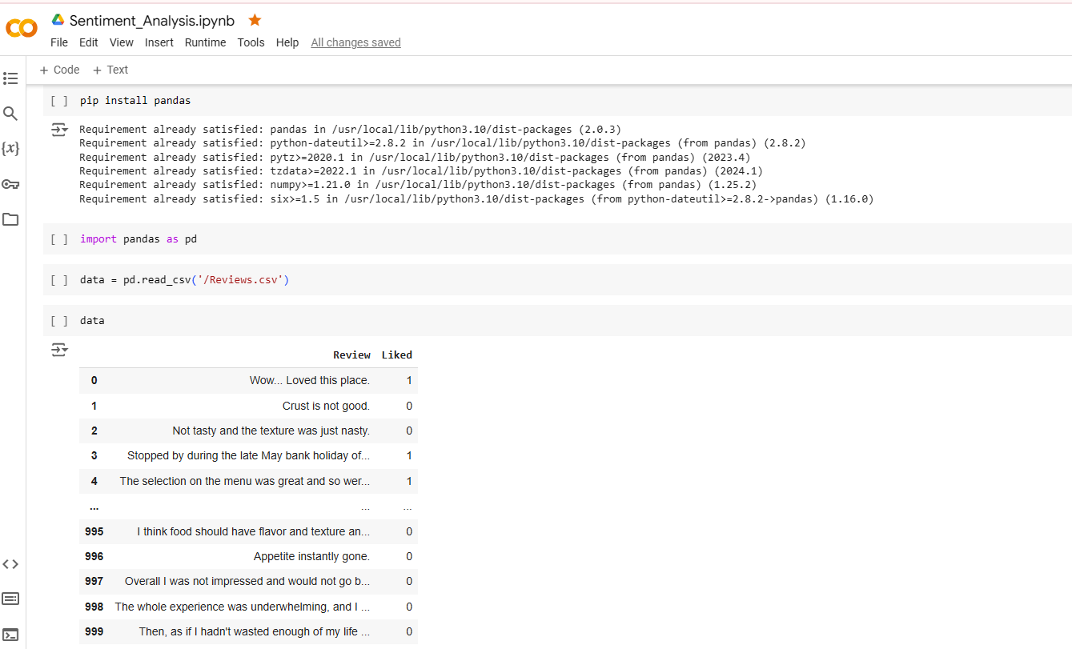
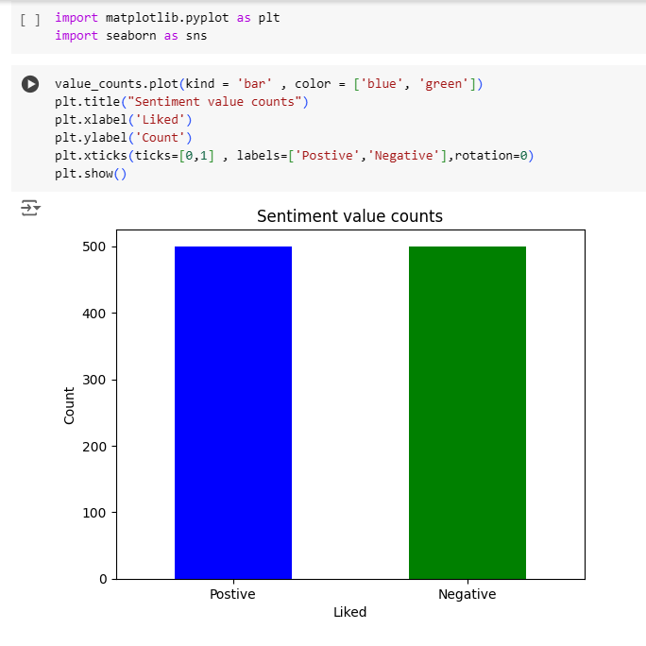
Result
Here I am providing the some results related to the Sentiment Analysis Reviews :

Slide 8
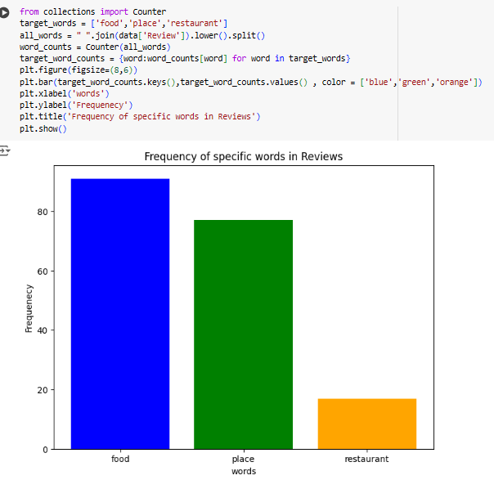
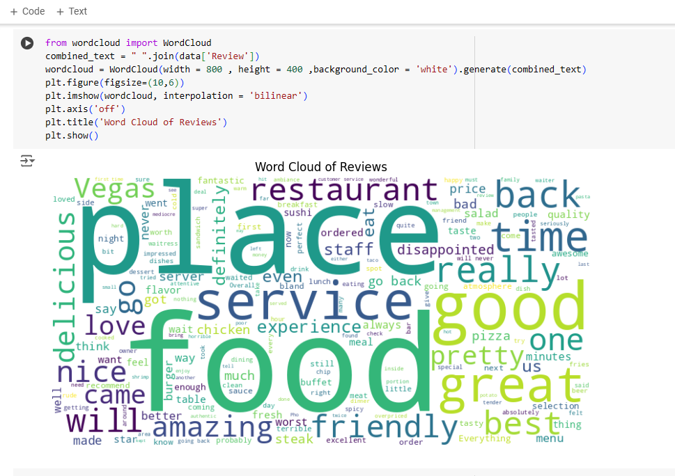
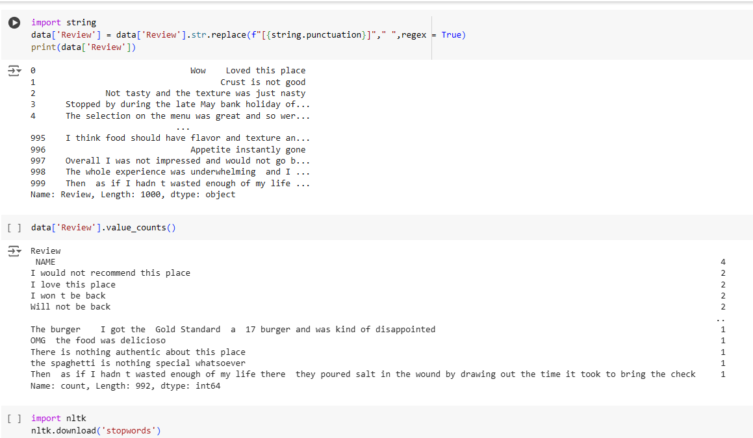
Cont…

Slide 9
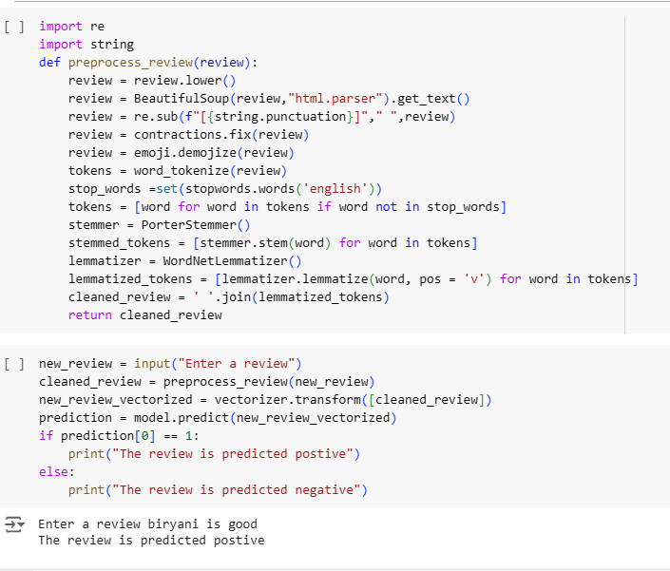
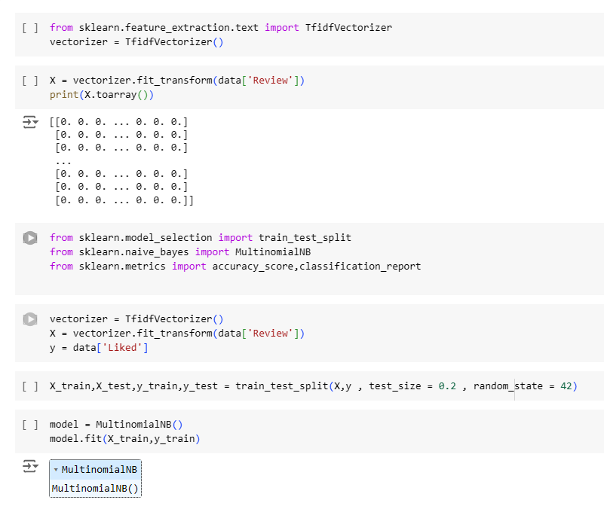
Cont…

Slide 10
Conclusion
In conclusion, our sentiment analysis model, based on the BERT architecture, has proven to be highly effective in accurately classifying restaurant reviews as positive or negative. By leveraging BERT's advanced contextual understanding capabilities, we have achieved a robust performance, ensuring the model generalizes well to new, unseen data. This tool provides restaurant management with valuable insights into customer sentiments, enabling data-driven decisions to enhance service quality and customer satisfaction. Overall, the implementation of this model demonstrates significant potential in automating sentiment analysis, saving time, and providing precise feedback on customer experiences.

Slide 11
The future scope of sentiment analysis in restaurant reviews is vast and promising. Enhancing the model to handle multi-lingual reviews can broaden its applicability globally. Incorporating aspect-based sentiment analysis can provide deeper insights into specific elements like food, service, and ambiance. Additionally, integrating real-time feedback systems and deploying the model in mobile apps can offer immediate sentiment analysis, helping businesses respond promptly to customer concerns. Exploring hybrid models that combine BERT with other techniques could further improve accuracy. Continuous updates and training with new data will ensure the model adapts to evolving language patterns and emerging customer trends.
Future scope

Slide 12
References
Text Books, Research papers, and articles that were instrumental in developing the proposed solution. This could include academic papers on Reviews for the Restaurants by the Sentiment Analysis, machine learning algorithms, and best practices in data preprocessing and model evaluation.

Slide 13
THANK YOU

